Slide 1

User Engagement Analysis
Om Devdas pawar

Slide 2
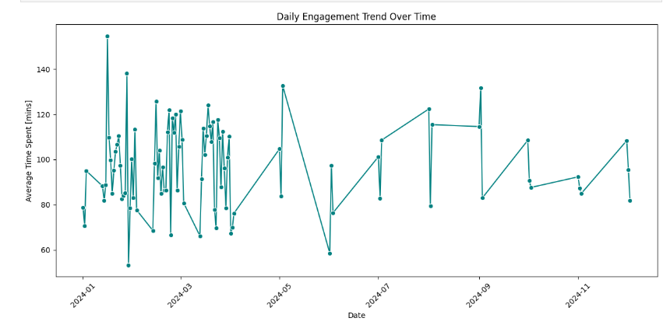
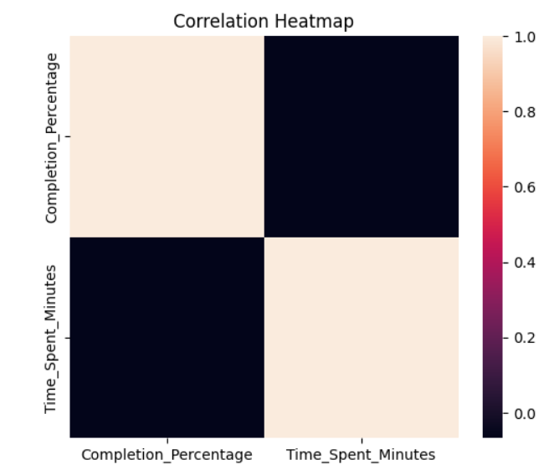
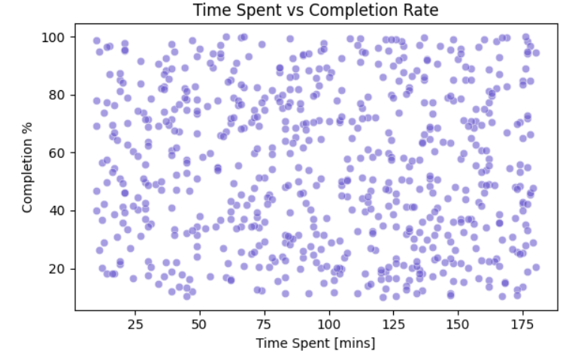
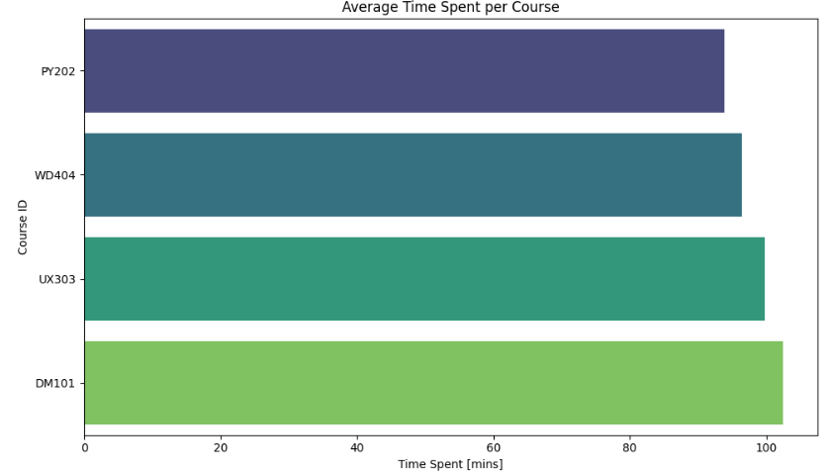
Key Metrics Visualized

Slide 3
Top 5 Insights
Courses with Short Duration Have Higher Completion Rates
Students Aged 25–29 Show the Highest Engagement
Feedback and Completion Rate Are Positively Correlated
Engagement Varies by Location
Course C102 Has the Highest Time Spent but Low Ratings

Slide 4
Top 3 Recommendations
Redesign Course C102 Based on Feedback Analyze negative reviews for Course C102 and make changes to improve clarity, pacing, or technical delivery.
Segment Campaigns by Age Group Since 25–29-year-olds are the most engaged, tailor marketing and upsell strategies toward them, while creating custom content formats for younger or older groups.
Implement Microlearning Modules Shorter lessons improve completion rates. Break down longer courses into smaller, goal-oriented units with checkpoints.

Slide 5
Thank you
Contact no: - 8828499296
E-mail :- pawarom14112002@gmail.com

